Slide 1

AWS Certified
Solutions Architect Associate C03

Slide 2
Module 1
Introduction to
Amazon Web Services

Slide 3
Introduction to Cloud Computing
Cloud Deployment and Service Models
Virtualization and Hypervisors
AWS Suite (with Analogy)
AWS Well-Architected Frameworks

Slide 4
Introduction to Cloud Computing

Slide 5
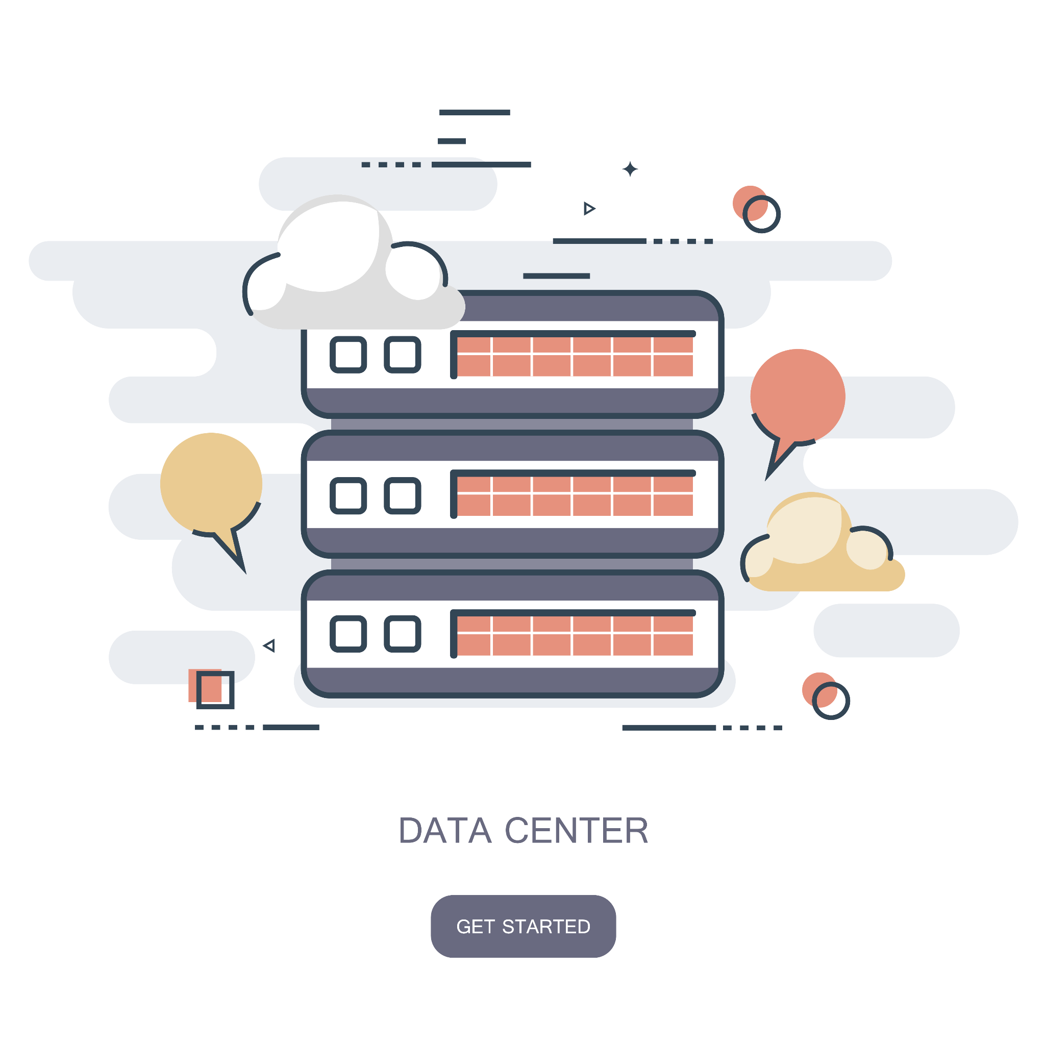
What Is Cloud?
The cloud is a distributed collection of servers that host software and infrastructure, and it is accessed over the Internet. The cloud can provide services over networks, i.e., on public networks or
on private networks, i.e., WAN, LAN, or VPN. Applications such as e-mail, web conferencing, and customer relationship management (CRM) all run in the cloud.

Slide 6
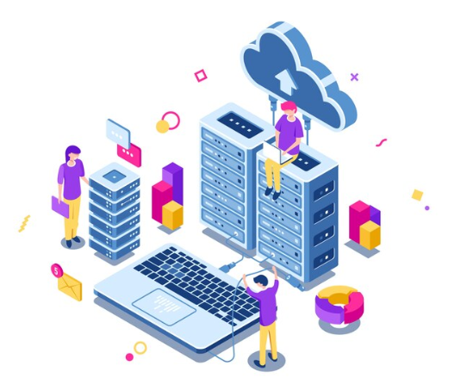
What Is Cloud Computing?
Cloud computing is like renting compute power and storage online. Instead of owning and maintaining your own hardware, you access servers and services over the internet. It's cost-effective, scalable, and allows you to use resources as needed, making it popular for businesses and individuals alike.

Slide 7
Cloud Deployment and Service Models

Slide 8
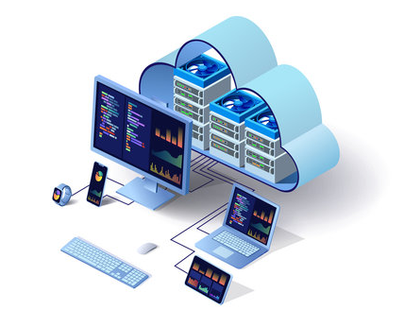
What Is a Cloud Deployment Model?
A cloud deployment model essentially defines where the infrastructure for your deployment resides and determines who has ownership and control over that infrastructure. It also determines the cloud’s nature and purpose.

Slide 9
Types of Cloud Deployment Models
Public Cloud
(Shared resources open to everyone)
Private Cloud
(Dedicated resources of organizations)
Hybrid Cloud
( A mix of public and private)

Slide 10

What Is a Cloud Service Model?
There are three main types of service models in cloud computing. Each type of cloud computing provides different levels of control, flexibility, and management, so you’ll select the proper set of services for your needs.

Slide 11
Types of Cloud Service Models
IaaS
Infrastructure as a Service
PaaS
PaaS
Platform as a Service
SaaS
Platform as a Service
Software as a Service

Slide 12
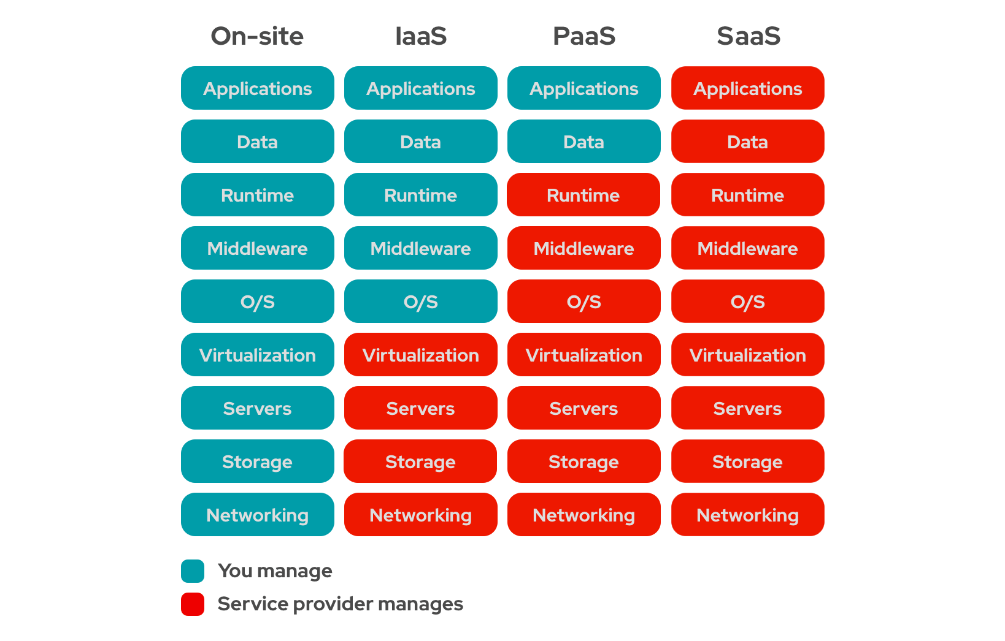
Understanding the Service Models

Slide 13
Virtualization and Hypervisor

Slide 14
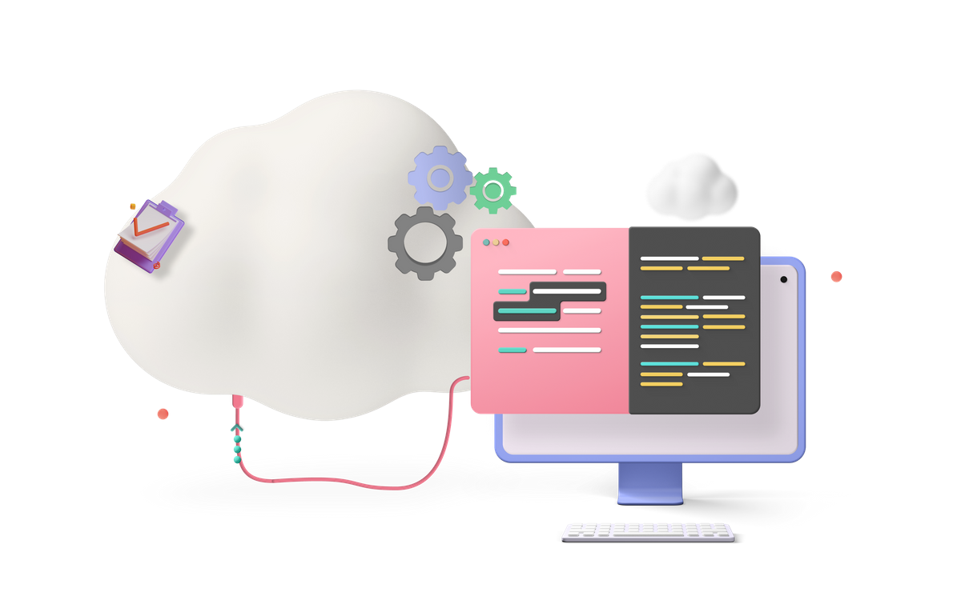
What Is Virtualization?
Virtualization is a technology that creates a simulated or virtual version of computer hardware, software, storage, or networks. It allows multiple operating systems or applications to run on a single physical machine, improving efficiency, resource utilization, and flexibility in IT infrastructure.
NOTE: Virtualization can exist without Cloud, but Cloud Computing cannot exist without Virtualization.

Slide 15

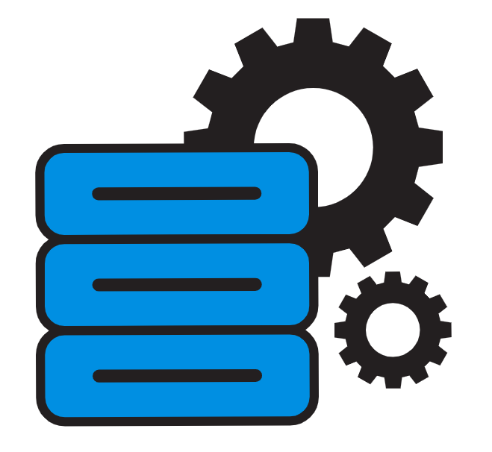

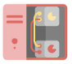
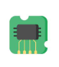
Types of Virtualization
Network
Combine multiple networks into one.
Hardware
Application
Virtualizes computer hardware components.
Runs apps independently of OS
Storage
Server
Aggregates storage into a virtual pool.
Multiple virtual servers on one

Slide 16
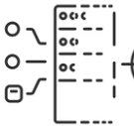
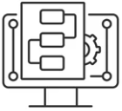
Advantages of Virtualization
Disaster Recovery
Resource Efficiency
Isolation
Cost Savings
Flexibility
Faster Provisioning

Slide 17
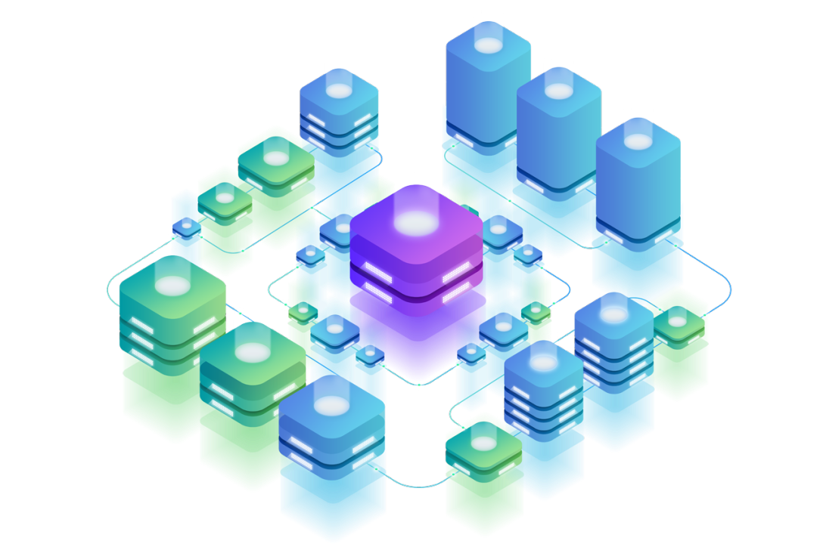
What Is a Hypervisor?
A hypervisor is software that enables multiple operating systems to run on a single physical machine simultaneously. It creates and manages virtual machines, allowing efficient resource utilization and isolation of different computing environments on the same hardware.

Slide 18
Types of Hypervisors
There are two main hypervisor types, referred to as “Type 1” (or “bare metal”) and “Type 2” (or “hosted”).
Hypervisors
Bare Metal
Hosted

Slide 19



Type 1 - Bare Metal Hypervisor
Type 1 hypervisors, or bare-metal hypervisors, install directly on hardware. It optimizes performance by avoiding an underlying OS, making it ideal for production servers where efficiency and resource utilization are paramount.
Guest 1
Hypervisor
Guest 2
Hardware

Slide 20

Type 2 - Hosted Hypervisor
A Type 2 Hypervisors, or Hosted Hypervisors, install on top of an existing operating system. It's suitable for development and testing, offering flexibility at the cost of slightly lower performance. Examples include VMware Workstation and Oracle VirtualBox.
Guest 1
Operating System
Hypervisor
Guest 2
Hardware

Slide 21
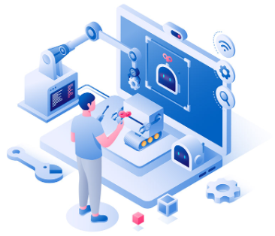
Virtualization in AWS
AWS achieves virtualization using the XEN hypervisor. Every AWS AMI uses the bare metal Xen hypervisor. Xen offers two types of virtualization: HVM (Hardware Virtual Machine) and PV (Paravirtualization).

Slide 22
AWS Suite

Slide 23


What Does the AWS Suite Consist of?
Networking
Compute
Databases
Monitoring
Storage
6 Serverless

Slide 24
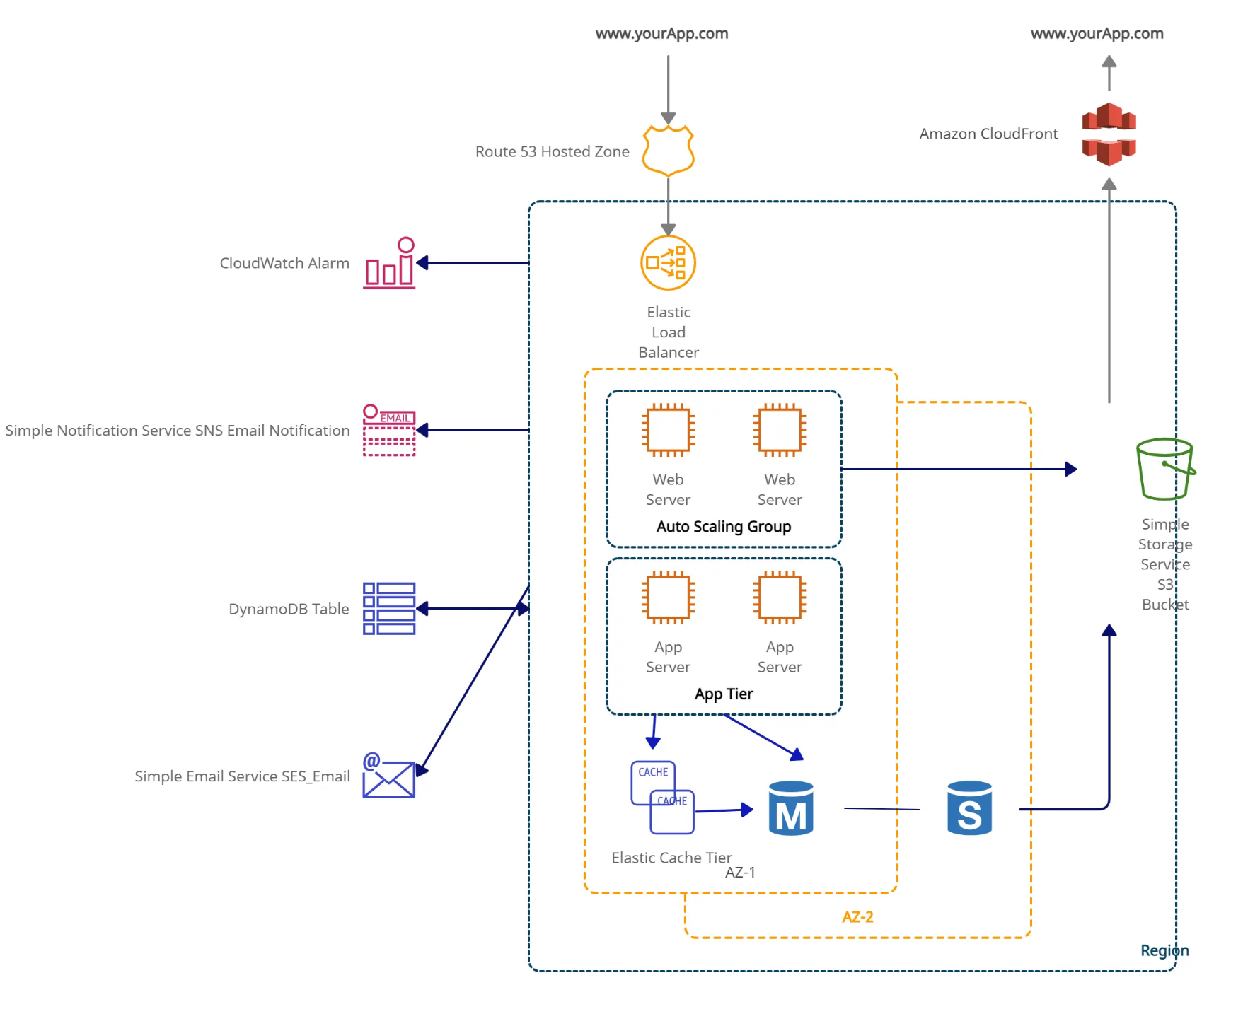
Case Study: AWS Services Architecture
www.intellipaat.com
www.intellipaat.com

Slide 25
AWS Well Architected Framework

Slide 26






AWS Well Architected Framework
Operational Excellence
Cost Optimization
Reliability
Performance Efficiency
Security
Sustainability

Slide 27

Operational Excellence
Operational Excellence
Optimize operations, understand processes, and improve continually for value delivery.
Guidance on best practices for DevOps, automation, observability, and infrastructure.
Refine operations procedures frequently.

Slide 28

Security
Security
The AWS Security pillar safeguards data, systems, and assets through cloud technology.
The security pillar offers best practices for identity management and infrastructure protection.
The security pillar comprises seven design principles emphasizing identity and traceability.

Slide 29

Performance Efficiency
Performance Efficiency
Efficiently utilizes resources, meeting demands, and adapting to evolving technologies.
Emphasizes efficiency, architecture selection, and advanced tech like serverless, machine learning.

Slide 30
Reliability
Reliability
The reliability pillar assures consistent workload performance, operation, and testing, offering detailed guidance for reliable implementations.
The pillar stresses robust foundations, resilient design, change management, and reliable failure recovery processes.

Slide 31

Sustainability
Sustainability
The sustainability pillar minimizes environmental impacts, focusing on energy efficiency.
Guidance on shared responsibility for sustainability, resource optimization, and minimizing downstream effects.
Prioritizes informed decisions balancing security, cost, performance, reliability, and sustainability.

Slide 32

Cost Optimization
Cost Optimization
Ensure resources are utilized optimally to avoid unnecessary expenses.
Prioritize cost reduction without compromising on delivering business value.

Slide 33
Hands-On Sign Up on AWS Management Console

